Slide 1

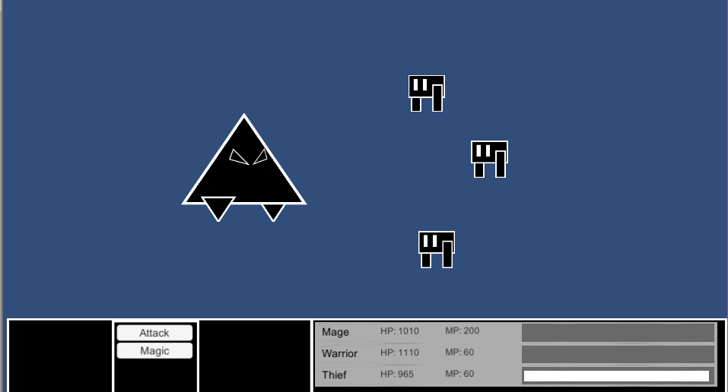
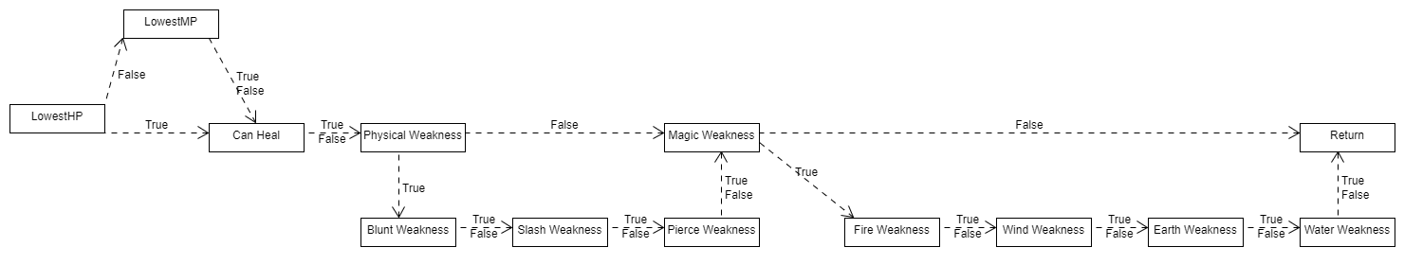
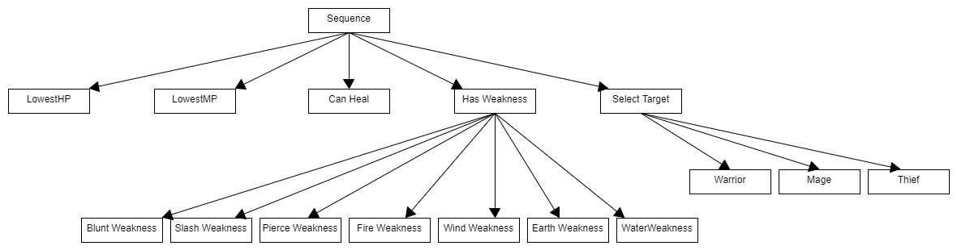
Can a Decision making AI be implemented into a Turn-based battle System?
Brandon Seah-Dempsey - C00204076
Introduction
Methods
Results
Conclusions
Artificial Intelligence has become an integral part of video game interaction between the video game’s world and it’s user.
This project studies existing AI models, techniques and open source code, in order to create my own Decision making AI based off what I’ve learned.
My goal is utilise what I’ve learned in and implement it into a Turn-based RPG style battle system similar to Final Fantasy.
For my research into AI models, I looked in various videos, websites, documents and open source code.
Eventually my findings led me to create a Behaviour and a Decision Tree, which would be integrated into the decision making of NPC of my project.
Using the results of my research, I was able to create and integrate a Behaviour and a Decision Tree into the Enemy NPC in a functional Turn-based battle system in Unity C#; which to produce results I had been hoping for with this project.
In conclusion, I was able to succeed in creating and implementing AI models I wish to utilise and was able to find success in not only seeing a decision making AI be incorporated into Enemy NPCs, but also success in that seeing that such a thing can work provided that the right approach is taken.
Bibliography
Ben Geisler (Unknown). Integrated Machine Learning For Behavior Modeling in Video Games. (Radical Entertainment).
Ben Geisler (Unknown). Integrated Machine Learning For Behavior Modeling in Video Games. (Radical Entertainment).
Tommy Thompson (April 4 2017). The Perfect Organism — The AI of Alien: Isolation. [Online]. (URL) https://becominghuman.ai/the-perfect-organism-d350c05d8960 .
Natasha Mathur (October 11 2018). Building your own Basic Behavior tree in Unity (Tutorial). [Online]. (URL) https://hub.packtpub.com/building-your-own-basic-behavior-tree-tutorial/ .
Code4Noobz (2019). C# – Decision Tree – Simple Example. [Online]. (URL) https://code.4noobz.net/decision-tree-simple-example//.

